Slide 1
Text Summarization
Stegarescu Ana-Maria, 507

Slide 2

Introduction
Summarization – abstractive vs extractive

Slide 3
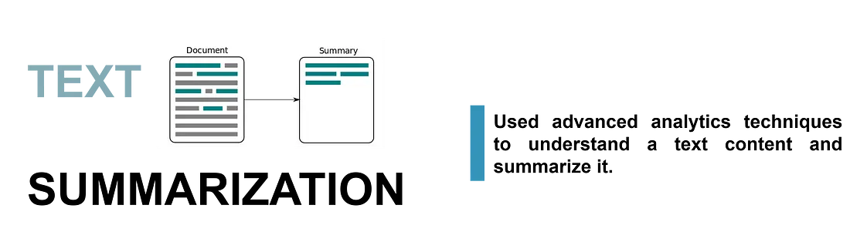
Introduction
T5
BART
Encoder-decoder:
Input to encoder: corrupted sentence
Input to decoder: original sentence
Target: dropped-out tokens
Bidirectional encoder
Left-to-right decoder
Pretrained on noisy text, target is de-noised text

Slide 4

Rouge-L
measures longest matching sequence of words using LCS (Longest Common Sequence)

Slide 5
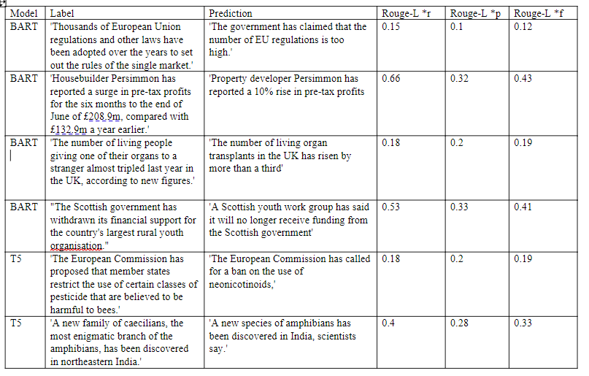

Slide 6

Information used

Slide 7
XSum dataset
(training, testing and evaluating)
Dataset for evaluation of abstractive single-document summarization systems. The goal is to create a short, one-sentence new summary answering the question “What is the article about?”. The dataset consists of 226,711 news articles accompanied with a one-sentence summary.

Slide 8
App template link: https://github.com/anjalp/Minimalistic-Flat-Modern-GUI-Template kaggle dataset for demo: https://www.kaggle.com/datasets/pariza/bbc-news-summary

Slide 9
Thank you!

